Slide 1

19: Find the spies
Hugo Li, Tiantian Sang, Muyang He

Slide 2

SUMMARY
Five people work together on a task that includes two randomly selected spies and three good guys. To prevent the spies from sabotaging all the tasks, the supervisor develops a rule. In odd-numbered rounds of the game, three people are selected to carry out the task, while in even-numbered rounds, only two people are selected. Some tasks are real, while others are decoys. As spies lack knowledge about the authenticity of the current task, they will try to vote against as far as possible in each task to increase the probability of affecting the true tasks. However, there is one exception: when a spy thinks that he may come under suspicion. For example, if a spy voted against the last round, causing the task to fail, then he is likely to vote True in the next round if selected once more.
There is no limit to the number of tasks, but the success of each task requires the unanimous agreement of all players. The spies have the option of voting for or against the task, while the good guys can only vote in True of the task. In addition, each person may not take part in the task for more than two rounds, and spies will ultimately be determined based on the results of each round.

Slide 3
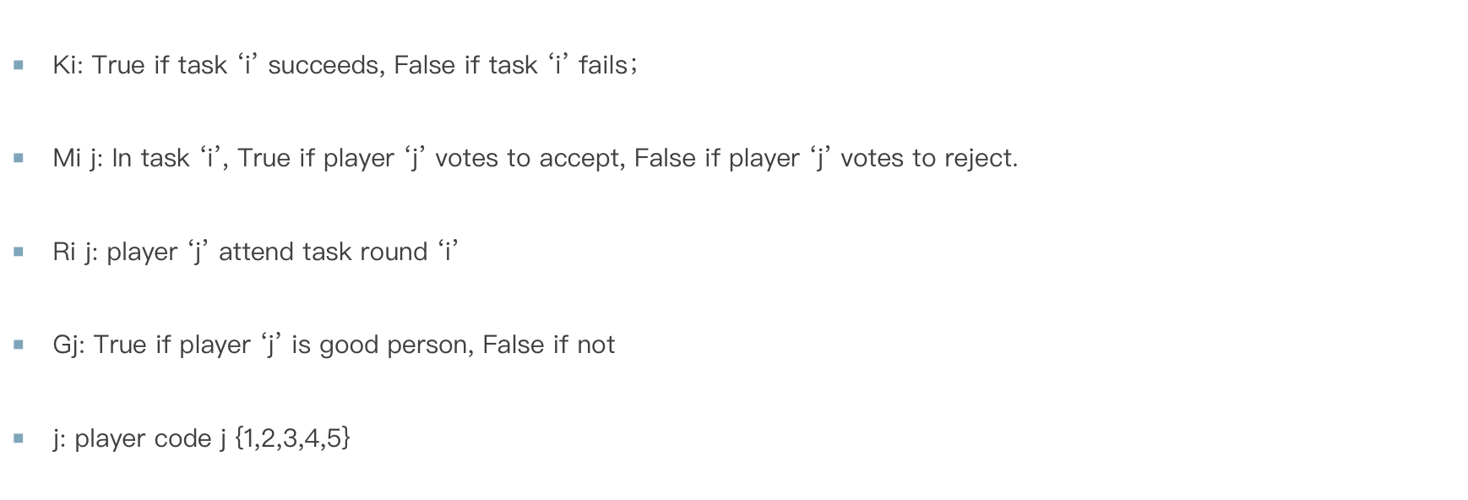
PROPOSITIONS

Slide 4
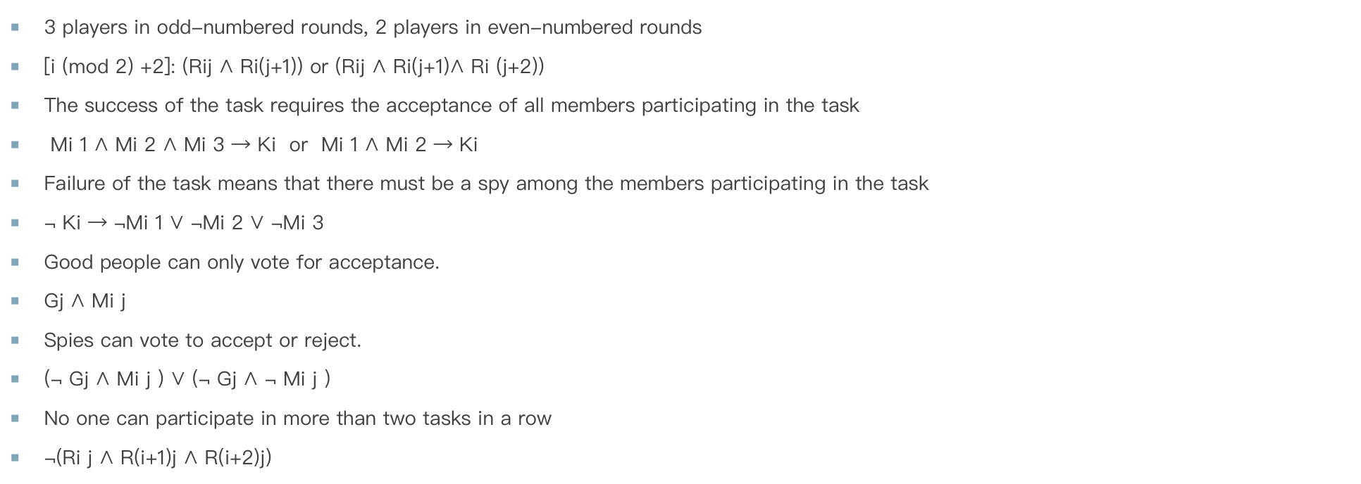
CONSTRAINTS

Slide 5
END
Thanks For Watching

